Slide 1

FINAL YEAR PROJECT PRESENTATION 22-FYP-302
NATIONAL TEXTILE UNIVERSITY FAISALABAD

Slide 2
PRESENTED BY ABDUL SAMI 18-NTU-1194 M.WASI ANWAR 18-NTU-1228 SULEMAN TARIQ 18-NTU-1233
PRESENTED TO
SUPERVISOR MAM SARA MASOOD
CO-SUPERVISOR DR MUDASSIR AHMAD

Slide 3
PRESENTATION FLOW
INTRODUCTION ABOUT PROJECT
PROBLEM STATEMENT
OBJECTIVE OF PROJECT
METHADOLOGY OF PROJECT
DIAGRAMS
CONCLUSION

Slide 4
INTRODUCTION TO PROJECT
The ADIS means Auto-Download and Installation System. The system was specifically designed and developed for the textile industry. The functionality of ADIS is it automatically downloads and installed the requested software’s into a system from the source system .
ADIS fetches the requested software from the server and downloads it into the destination and MSI that is an installer that is used to auto-complete the entire basic configuration needed in the installation of required software.

Slide 5
PROBLEM STATEMENT
To install the different software a person has to download it by going through multiple websites or platforms, also it's time taking and not easy to configure the software at the time of installation. Going through multiple websites and platforms isn't secure for the system and data. Any malware can attack and harm the system and it’s data while visiting website or downloading packages of applications.

Slide 6
OBJECTIVES OF PROJECT
Easy to use
Availability of platform
Availability of required software's
Automated
Get rid of pirated software's
Time saving
Secure Network

Slide 7
Methodology

Slide 8
Adaptive Methodology.
We are using the prototype model along with Incremental Model as we are testing, designing, and coding the device one module and feature at a time and improving on it afterwards

Slide 9
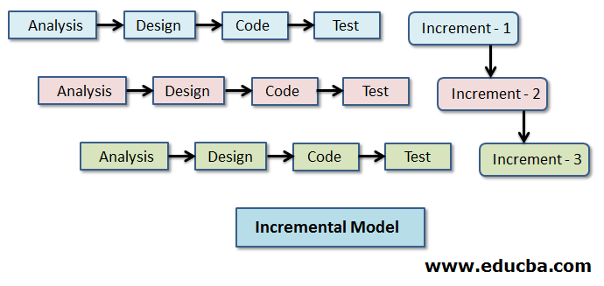
Incremental Model

Slide 10
Prototype
Requirement Elicitation.
Requirement analysis
Design
Prototyping
Review and Updating
Customer Evaluation
Development
Testing
Maintenance

Slide 11
Diagrams

Slide 12
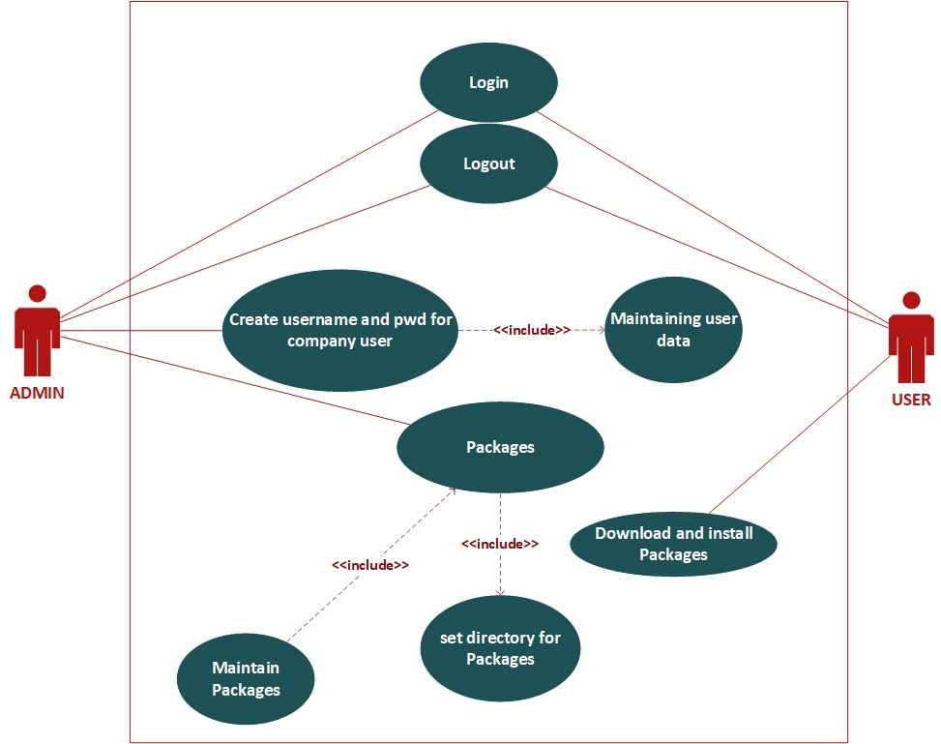
System Use Case Diagram

Slide 13
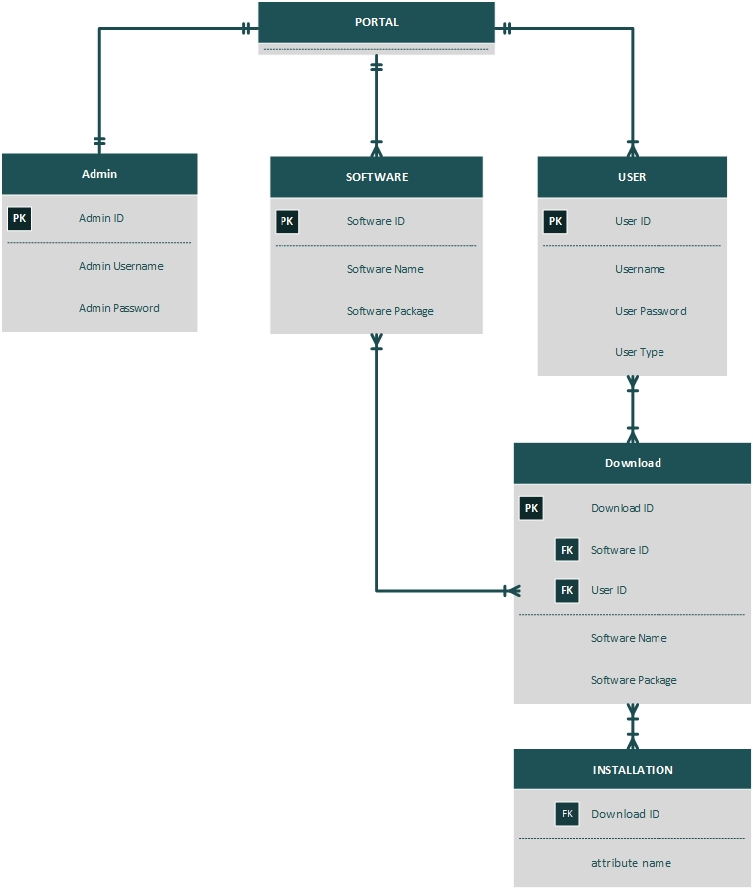
ERD OF SYSTEM

Slide 14
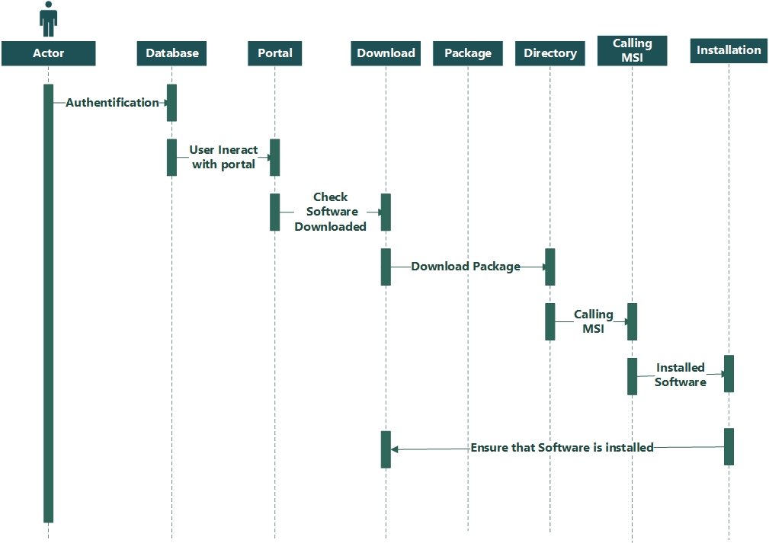
Sequence Diagram of Overall system

Slide 15
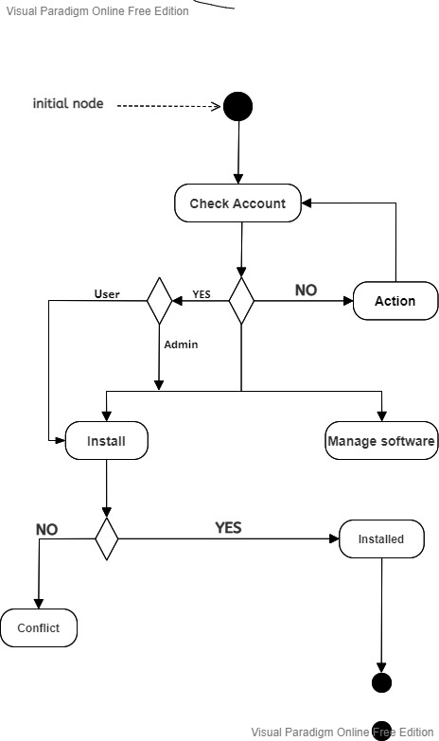
Activity Diagram

Slide 16
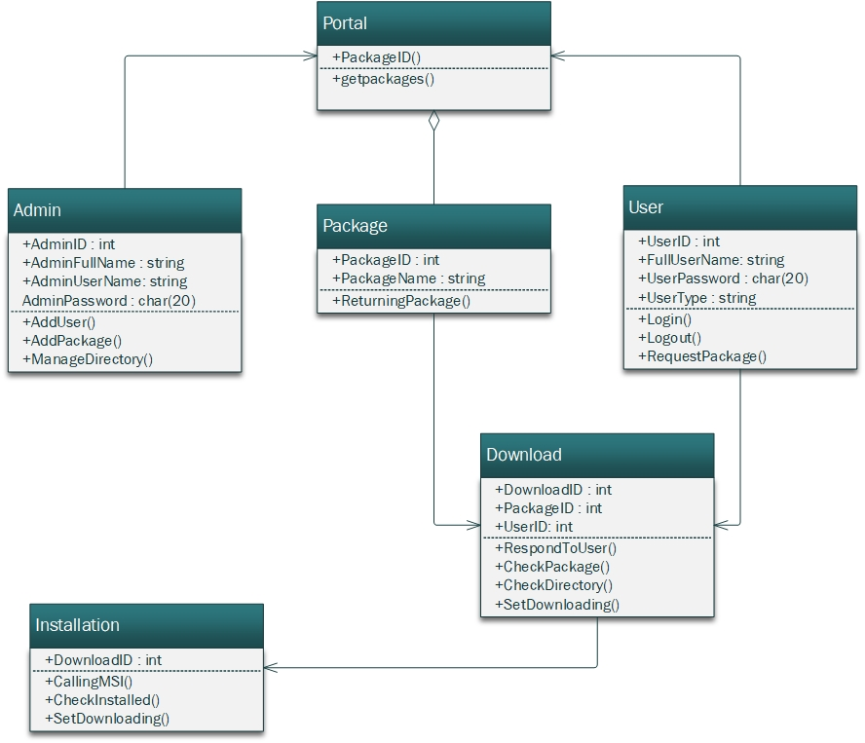
Class Diagram

Slide 17
CONCLUSION
Easy to use and manage
Automatic working
Time saving
All the software's on one platform
Safe and secure

Slide 18


